Slide 1
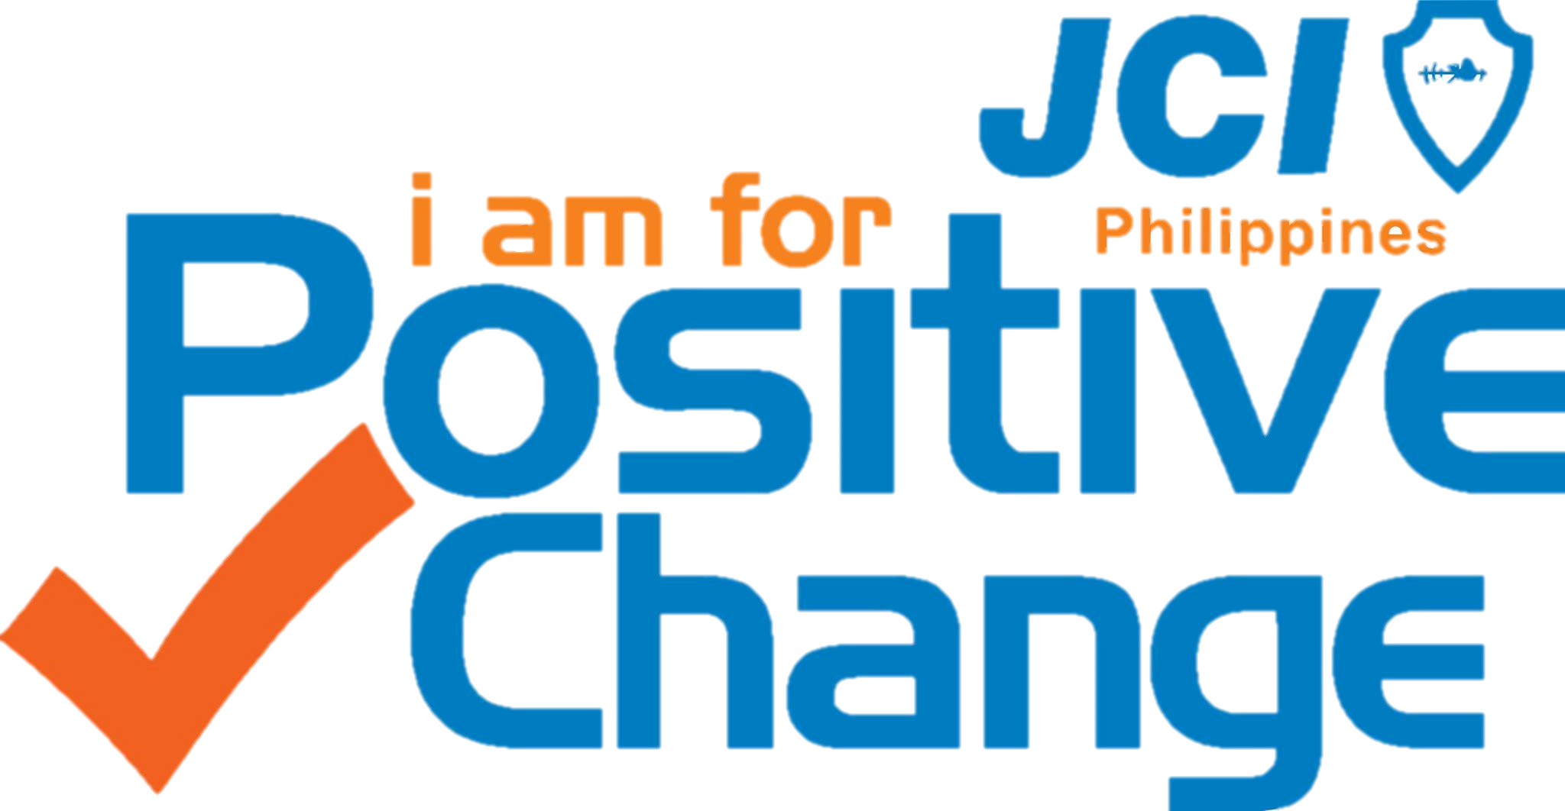
Alignment Process: Introduction to Area, Region, LO Planning Activities
Prepared and compiled for JCI Philippines by:
CHRISTOPHER M. CAMBA
2015 National Secretary General
Senator #71341
Source: jci.cc
Notes:
To have your National or Local Organization’s logo appear automatically on every new slide, follow the instructions below.
Click on View-> Master -> Slide Master
Click on Insert-> Picture-> From file and select the file of your logo. Or copy and paste your logo from another document.
Move your logo into the lower left corner, as indicated by the gray box. If it is necessary to reduce the size of the logo, be sure to maintain the proportions by holding down shift when using the arrow at the corner of the picture to resize. Increasing the size of the logo image may make the image blurry or degraded and is not recommended.
After your logo is in the correct position on the cover slide, select the second Master Slide shown at left.
Click on Insert-> Picture-> From file and select the file of your logo. Or copy and paste your logo from another document or page.
Move your logo into the space indicated by the gray box, keeping in mind the recommendations above.
Click on the button “Close Master View” or click on View-> Normal.
Delete the gray boxes to show your logo.
Para que el logotipo de tu Organización Nacional o Local aparezca automáticamente en todas las diapositivas (“slides”), en la posición donde está el cuadro gris, sigue las instrucciones que aparecen a continuación.
1. Haz clic en Ver -> Patrón -> Patrón de diapositivas
2. Haz clic en Insertar-> Imagen -> Desde archivo y selecciona el archivo donde se encuentra tu logotipo. También puedes copiar el logotipo de otro documento y pegarlo (“paste”) en la diapositiva.
3. Traslada el logotipo hasta la esquina inferior izquierda, donde está el punto rojo. Si necesitas reducir el tamaño del logotipo, asegúrate de conservar las proporciones manteniendo presionada la tecla de mayúsculas (“shift”) mientras utilizas la flecha para agarrar la imagen por una esquina y alterar el tamaño. No es recomendable aumentar el tamaño del logotipo, ya que esto puede causar que la imagen se vea borrosa o pierda calidad.
4. Una vez que el logotipo se encuentre en la posición correcta en la diapositiva que servirá de portada de la presentación, selecciona la segunda Diapositiva que aparece a la izquierda.
5. Haz clic en Insertar-> Imagen -> Desde archivo y selecciona el archivo donde se encuentra grabado tu logotipo. También puedes copiar el logotipo de otro documento o página y pegarlo en la diapositiva.
6. Traslada el logotipo hasta la esquina inferior izquierda, donde está punto rojo, teniendo en cuenta las recomendaciones indicadas anteriormente.
7. Haz clic en el botón “Cerrar Vista Patrón” o haz clic en Ver -> Normal.
8. Borra los cuadros grises para que se pueda ver tu logotipo.
Pour que le logo de ton Organisation nationale ou locale apparaisse automatiquement sur chaque nouveau transparent, veuille suivre les instructions ci-jointes.
1. Clique sur View-> Master -> Slide Master
2. Clique sur Insert-> Picture-> (insérer image) dans fichier et sélectionne le fichier de ton logo. Tu peux aussi copier et coller ton logo d’un autre document.
3. Déplace ton logo pour le placer en bas à gauche, comme l’indique la case grise. Il se peut que tu aies à diminuer la taille du logo. Dans ce cas veille à garder les proportions en appuyant sur la touche shift lorsque tu utilises la flèche sur le côté de l’image dont tu souhaites changer la dimension. Si tu augmentes la talle du logo, il se peut que l’image soit déformée ou pas très nette et donc il n’est pas recommandé de le faire.
4. Une fois que ton logo se trouve à l’endroit voulu sur le transparent de garde, sélectionne le deuxième Master transparent qui apparait à gauche.
5. Clique sur Insert-> Picture-> dans fichier et sélectionne le fichier de ton logo. Tu peux aussi copier et coller ton logo d’un autre document ou page.
6. Déplace ton logo dans l’espace indiqué par la case grise, en tenant compte des recommandations précédentes.
7. Clique sur la touche “Close (fermer) Master View” ou clique sur View-> Normal.
8. Supprime les cases grises pour que ton logo soit bien visible.

Slide 2
THIS MATERIAL IS RECOMMENDED TO BE CONDUCTED AS AN INTRODUCTION TO 2015 AREA, REGION OR LO PLANNING SESSION.

Slide 3
Alignment Process:
Introduction to Area, Region & LO Planning Activities
The Planning Kit includes the following materials for reference:
2014-2018 JCI Strategic Plan
2014 JCI Plan of Action
Active Citizen Framework
Impact Strategy
JCI Local Action Guide: Plan of Action
JCI Local Action Guide: Local Planning Process
2015 Draft NOM Calendar

Slide 4
Active Citizenship, our way forward! Understanding the thrust of JCI, as a world organization
Sources:
jci.cc
2014-2018 JCI Strategic Plan
JCI Impact Strategy course
JCI Impact course
Notes:
Welcome and Introduction
Slide Summary: Speaker welcomes participants and introduces the session:
Speaker Notes: We are living in a world of change. It is evident from the continuous technological advancements we witness each year, the catastrophic natural events we see on the news, and the shifting global economic, political and social climate we experience in our own communities. With the world changing… evolving… and growing over the next decades, JCI must adapt and evolve too. Our members and organization must move forward in a new direction. The same JCI Mission and Vision – but new goals, new actions and new strategies. A goal that will propel us into the future. A focus fit for the 21st century.
Today’s session will focus on that direction JCI wants to move, the goal we will accomplish; and the actions we can take to achieve that goal and ensure JCI exists in communities creating impact for another 100 years.

Slide 5




Notes:
II. JCI’s Long Term Goal
a. What does this goal mean?
Speaker introduces JCI’s long-term goal for the future, a result of the 2013 Strategic Planning Committee’s work and part of the 2014 – 2018 JCI Strategic Plan:
JCI will be the organization that unites all sectors of society to create sustainable impact. This is JCI’s long-term goal for the future. You may also recognize it as our strategic position statement, an outcome of the 2013 JCI Strategic Planning Committee’s work and outlined in the 2014-2018 JCI Strategic Plan. This statement describes how JCI is recognized in the future, how society and the world perceive us as an organization.
A strategic position statement should also define a specific need and how the organization is uniquely positioned to address this need. We are all well aware of the challenges facing our world: poverty, hunger, disease, unemployment, conflict. We also know that it will take more than one JCI member or even one JCI Local Organization to solve the greatest challenges facing our communities. It will take all sectors of society working together in collaboration; taking ownership for both the challenges and the solutions that will lead to sustainable impact.
Pose the question: How long do you think it will take us to achieve this goal? To be recognized as the organization that unites all sectors of society to create sustainable impact?
It is important to note that this is not a goal for tomorrow, or even a year from now or even five years from now. This is a goal for 30 years from now, when it will be your kids and then grandkids who will be running this organization.
To build JCI into the organization that unites all sectors of society to create sustainable impact, it will take hard work, big ideas, and concrete actions. So let us take a minute to discuss how we will attain this goal and the kinds of ideas and actions we will need.

Slide 6
What should be our focus?
“To make a citizen, a better citizen.”
We provide opportunities for our members. Our focus has been on the individual.
What is the focus of JCI as an organization?
What is the reason of its existence?
JCI have been driven by the vision for a better world since 1915
Notes:
(Ask the audience)
Is this true? Can you site examples supporting our focus to our members?
Does it speak of JCI and its reason of existence?
For too long our focus has been on the individual – we get to hear “University of Leaders “SELF – Social, Economic, Leadership and Fellowship” or “4 Areas of Opportunities”
Its not about the numbers.
Its not about the titles.
Its not about the money.
Its not about the personal development.

Slide 7
What should be our focus?
INDIVIDUAL
IMPACT!
JCI have been driven by the vision for a better world since 1915
It is about the
Notes:
It is about the impact.
It is about what we do with the numbers, with the title, with the money, with what we learned to create impact.

Slide 8
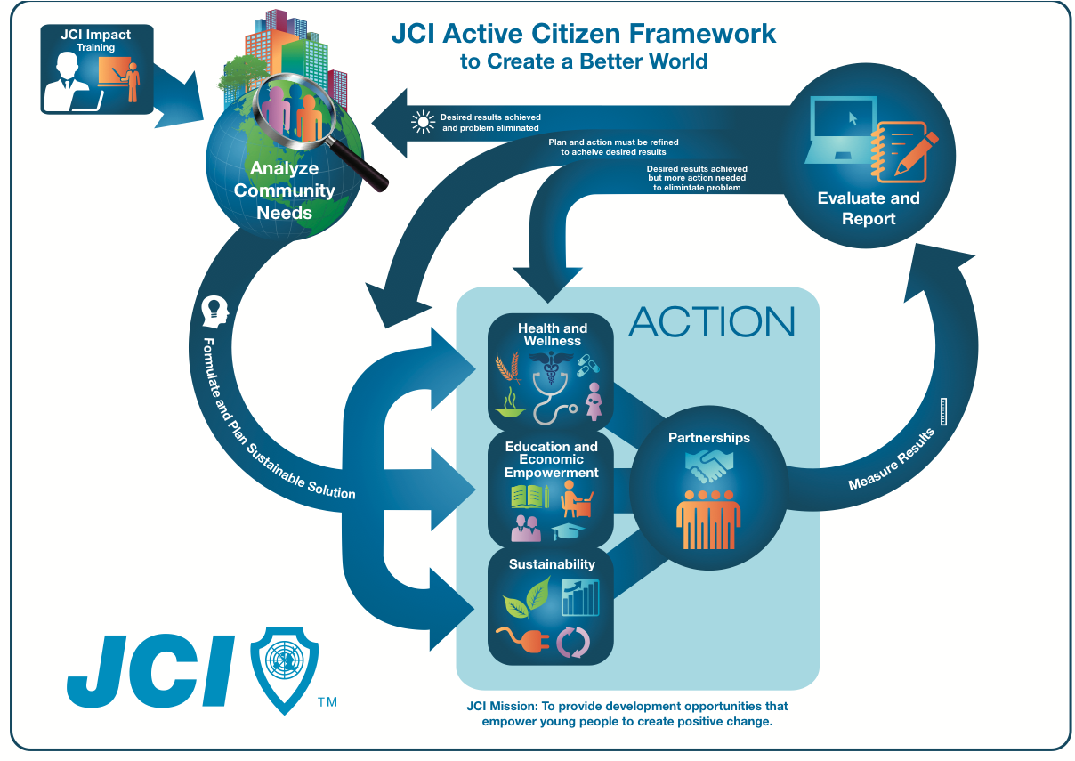
Strategic Tool
Assessing Community
Needs
Evaluating Results
Formulating and Implementing Sustainable Solutions
Collaborating and Engaging Stakeholders
Notes:
VI. Closing
a. JCI’s Strategic Tool: The JCI Active Citizen Framework
Knowledge of the JCI Active Citizen Framework is necessary to enable communities to achieve sustainable impact.
The JCI Impact Strategy is all about taking action that enables communities to create sustainable impact. To enable communities to do this we talk of both targeting communities where JCI exists currently and those where we do not using the JCI Impact Strategy, however sustainable impact is created and achieved through the collective ACTION of active citizens across local communities. Designed to address all types of community issues, JCI members are guided by the JCI Active Citizen Framework, which provides a methodology for conducting impactful projects.
As you all know and have discussed the process consists of assessing community needs, formulating sustainable solutions, and evaluating results to ensure sustainability. Community partners, business owners and government officials are engaged throughout each step of the process. The collaborative ownership of challenges and solutions by all community stakeholders is what produces sustainable impact. Creating sustainable impact is important because it leads to a world where human security is a reality for all global citizens. Something that is not a reality for billions of people today. And as an organization that empowers young people to create positive change in local communities across the world, JCI is uniquely positioned to address this need.
Therefore knowledge of the Active Citizen Framework and how this process can guide you to unite all sectors of society to create sustainable impact, is necessary to implement the impact strategy.

Slide 9
What is the end result?
Committed to creating positive change, JCI members will run impactful projects.
In the process, young people are encouraged to take responsibility for local issues, and targeted, sustainable solutions are implemented.
Solutions to identified challenges are reached by involving all sectors of society.
JCI served as the driving force to unite government, businesses and the civil sector to collaborate for impact.
Notes:
Committed to creating positive change, JCI members run impactful projects. They are not just focused on charity or service to the community. Active citizenship is about creating sustainable impact. We encourage young people to take responsibility for local issues, and find targeted, sustainable solutions that benefit our communities and the world. Guided by the passion to lead the world in a new direction, JCI members have the courage to address the critical challenges of our time. Solutions to these challenges can only be reached by involving all sectors of society. Solutions that ensure healthy communities, drive economic empowerment, and secure a sustainable world. JCI will be the driving force to unite government, businesses and the civil sector to collaborate for impact.

Slide 10
I am for Positive Change, a call to unite and act Understanding the thrust of JCI Philippines
Sources:
jci.cc
2014-2018 JCI Strategic Plan
JCI Impact Strategy course
JCI Impact course
Notes:
Welcome and Introduction
Slide Summary: Speaker welcomes participants and introduces the session:
Speaker Notes: We are living in a world of change. It is evident from the continuous technological advancements we witness each year, the catastrophic natural events we see on the news, and the shifting global economic, political and social climate we experience in our own communities. With the world changing… evolving… and growing over the next decades, JCI must adapt and evolve too. Our members and organization must move forward in a new direction. The same JCI Mission and Vision – but new goals, new actions and new strategies. A goal that will propel us into the future. A focus fit for the 21st century.
Today’s session will focus on that direction JCI wants to move, the goal we will accomplish; and the actions we can take to achieve that goal and ensure JCI exists in communities creating impact for another 100 years.

Slide 11
for JCI Philippines, what do we want to achieve?
TO ensure that we achieve alignment of efforts, that what we are doing locally will contribute to our Vision, Mission and Values and will add value to the new thrust of JCI, which is the shift to Impact.
To achieve such alignment, we need to understand the 5 Year Plan of Action of the world organization that is to drive Actions that -- Impact, Motivate, Invest, Connect and Collaborate.

Slide 12
How do you select and develop your LO programs and projects for Y2015?
Notes:
Ask to give examples – understand the thinking and decision process and relate it to ACF and Impact Strategy.

Slide 13
What should our local programs look like?
• Use the 5 strategies of Impact, Motivate, Invest, Connect, and Collaborate
• Your projects must be aligned with the thrust of JCI World and JCI Philippines.
• Your Plan of Action as a chapter must be based on the Plan of Action of JCI World.

Slide 14
How should we define our 2015 JCI Programs and Initiatives?
How can we create an impactful year?
Our programs should empower JCI members towards making JCI Philippines as solutions provider, with our Creed and Active Citizen Framework as our guide.
How can we be relevant to the community?
Our programs should drive a change in our mindset towards implementing sustainable and measurable programs that address community problems or needs.
How can we concretely create positive change?
Our programs should be able to concretely drive positive change, improving the way we do things in order to improve the lives of all stakeholders, JCI Members included.

Slide 15
How should we define our 2015 JCI Programs and Initiatives?
I am for Positive Change
IMPACT
MOTIVATE
INVEST
COLLABORATE
CONNECT
Will our National/Area/Region/LO Programs enable our communities to achieve impact?
Will our National/Area/Region/LO Programs create an environment in which people are motivated towards positive change?
Will our National/Area/Region/LO Programs create a financial plan that will invests on long-term goals?
Will our National/Area/Region/LO Programs bring together like-minded partners to expand mutual impact?
Will our National/Area/Region/LO Programs
connect people, the community and global society?

Slide 16
Actions that IMPACT
OUR GOAL: JCI Philippines will enable communities to achieve impact through our National and Local Programs.
OUR ACTIONS:
Implement sustainable programs according JCI Active Citizen Framework (ACF).
Deploy the 5x5 Impact Strategy to engage young active citizens in the community.
Increase your membership and/or extnd new or revive Local Organizations
Implement JCIP National Programs timely: January - UNMDG, March - YLEA, Bags to School and Pinay Power, April - JCI Week and Beyond Prison Walls, September - Peace Month, Yearlong - Oplan Kaagapay, etc.
Be JCIPEA Efficient!
Note: Access our online calendar for you to know the different National Programs for implementation in 2015 and the corresponding schedules for reference --- http://teamup.com/ks31f30b46cefd95c6/
Notes:
Institutionalize JCI Active Citizen Framework (ACF) programs that address the Sustainable Development Goals (or UNMDGS): Ensure that our programs are developed according to ACF.
Deploy the 5x5 Impact Strategy: Ensure that young active citizens of the communities we serve or partner with are engaged and activated.
Increase your membership and/or extend new or revive Local Organizations (especially in areas where there is no JCI presence). Ensure that more young active citizens commit to drive our Values.
Implement JCIP National Programs timely: January - UNMDG, March - YLEA, Bags to School and Pinay Power, April - JCI Week and Beyond Prison Walls, September - Peace Month, Yearlong - Oplan Kaagapay, etc. Ensure that we celebrate and execute these programs all together (nationwide) and on time to drive its value and create greater impact.
Be JCIPEA Efficient!

Slide 17
Actions that MOTIVATE
OUR GOAL: JCI Philippines will create an environment in which people are motivated towards positive change.
OUR ACTIONS:
Execute the JCIP Training Scorecard.
Appoint and engage the Area, Region and LO Training Directors and Training Plans are accordingly developed.
Build pool of competent trainers.
Conduct JCI Official and Non Official Courses.
Create and conduct skills development courses especially Parliamentary Procedures and Project Management.
Conduct “Opportunity to Impact,” our new members orientation program.
Involve or promote TOYM / TOYP to recognize individuals who are model of impact.
Participate in the Area, National (or even ASPAC and World) JCI Awards Programs.
Provide local recognition programs for members.
Notes:
Execute the JCIP Training Scorecard. Ensure that each LO is providing an environmental that nurtures active citizenship, where opportunities to develop members are available.
Appoint and engage the Area, Region and LO Training Directors in managing all individual and organizational developmental needs and delivering relevant programs to meet these needs through their Training Plans. Ensure that appointments are made and TDs are engaged.
Conduct JCI Official and Non Official Courses to empower members to create sustainable impact
Create and conduct skills development courses relevant for their respective roles as active citizens (leaders, members, trainers, etc) – Parliamentary Procedures, Project Management, etc.
Conduct “Opportunity to Impact,” our new members orientation program.
Involve or promote TOYM / TOYP to recognize individuals who are model of impact. Ensure we recognize them in sharing their experiences to inspire current members or attract new ones.
Utilize JCI Awards Programs to highlight stories of impact. Ensure that LO participates in the Area, National, ASPAC or World Awards Programs to celebrate the members contributions and hardwork.

Slide 18
Actions that INVEST
OUR GOAL: JCI Philippines will create a financial plan that will invests on long-term goals.
OUR ACTIONS:
Participate in the 100th Year JCI Philippines Gala to meet and network with possible funders or corporate partners. Or organize a similar event locally.
Develop a measurable and sustainable financial growth plan.
Market the JCIP online store and merchandise. Participate by promoting local products to be part of it.
Explore collaboration with businesses owned by JCI Members.
Submit project proposals for Corporate Social Responsibility initiatives of major companies.
Notes:
Participate in the 100th Year JCI Philippines Gala to meet and network with possible funders or corporate partners. Or organize a similar event locally.
Develop a measurable and sustainable financial growth plan, identifying and tapping partnership opportunities available in the community. Ensure that long term partnership, beneficial to both parties, is also developed in the process.
Launch and market the JCIP online store and merchandise. Participate by promoting local products to be part of it as well.
Explore collaboration with businesses owned by JCI Members as continuous source of funds.
Submit project proposals for sustainable and relevant ACF programs to local companies for their Corporate Social Responsibility initiatives.

Slide 19
Actions that COLLABORATE
OUR GOAL: JCI Philippines will bring together like-minded partners to expand mutual impact.
OUR ACTIONS:
Introduce programs that will position JCIP as an organization that will unite all sectors of society to create sustainable impact
Attend JCI and non-JCI conferences and summits.
Celebrate JCI Active Citizen Day (foundation day) and JCI 100th Year of Impact to bring in the different sectors of the society and rally them to drive our key programs.
Participate in JCI Twinning Program.
Encourage collaboration internally among various Programs. Organize joint projects at all levels. Co-brand 2 or more programs where 2 different programs are packaged and delivered together.
Partner with other professional groups, government associations and other relevant assemblies.
Notes:
Introduce programs that will position JCIP as an organization that will unite all sectors of society to create sustainable impact like organizing or leading a multi-sectoral disaster response / assistance (Oplan Kaagapay) groups.
Attend JCI and non-JCI conferences and summits to expand our network and spot possible partners (AreaCon, NatCon, Midyear Academy, Presidents Academy, Training Summit, ASPAC, WorldCon, UN Summit)
Celebrate JCI Active Citizen Day (foundation day) and JCI 100th Year of Impact. Attend the JCIP Gala Event or organize local activities to bring in the different sectors of the society and rally them to drive our key programs.
Participate in JCI Twinning Program.
Encourage collaboration internally among JCIP National/Area/Regional/LO Programs to deliver greater value and impact and optimize resources. Organize joint projects at all levels. Co-brand 2 or more programs where 2 different programs are packaged and delivered together –like the “Batang Active Citizens in Action” 3-way Collaboration between Training, UNMDG and YLEA.
Partner with other professional groups (People Management Association of the Philippines, Chamber of Commerce), government associations (National Movement of Young Legislators, Philippine Councilors League, League of Municipalities) and other relevant assemblies.

Slide 20
Actions that CONNECT
OUR GOAL: JCI Philippines will connect people, the community and global society.
OUR ACTIONS:
Share JCI Active Citizen Framework concept to the community.
Conduct My World Campaign (Forum and Survey) locally.
Engage members in educating and training the community of several core skills of JCI like Parliamentary Procedure and Project Management.
Understand our NOM Tagline “I am for Positive Change” and align our LO theme for the 2015 to drive it locally.
Encourage media and PR exposures for all JCI initiatives. Utilize Social Media, ensuring our positive presence in all different online communities available.
Establish an effective communication channels to increase exchange of information at all levels of the organization. Engage all secretaries to keep track of circulars and information shared by National, Area or Region.
Notes:
Share JCI Active Citizen Framework concept to the community.
Engage members in educating and training the community several core skills of JCI like Parliamentary Procedure and Project Management through our “Active Citizens in Action” Training Program.
Understand and cascade the key messages of our NOM: 1) Tagline “I am for Positive Change” 2) Specific messages of each of our national programs.
LOs to articulate clearly their LO theme for the 2015 as to how it aligns and supports our organizational call “I am for Positive Change!”
Encourage media and PR exposures, and develop relationship accordingly.
Establish an effective communication channels to increase exchange of information at all levels of the organization. Engage all secretaries to keep track of circulars and information shared by National to Area to Region to LO.

Slide 21
It’s 2018.
It’s Year 2018. Over the past 5 years, JCI became the organization for active citizens across all sectors. Across all occupations. Across all communities. We, the JCI community, changed our mindset. Transformed our direction. Shifted our attention. Shifted from membership. Shifted to impact. Inspired new goals. Ignited change.
Focused on Impact, Motivation, Investment, Collaboration and Connection
We created a better world. A world where communities achieve impact. People are motivated toward positive change. Long-term goals are invested in. Partnerships expand mutual impact. People, their communities and the global society are connected.
This is a good start. A solid foundation. We made an impact. A big impact. There is still more to be done.
Looking back, what can you say you’ve done to contribute to a better world in 2018? How will you continue to create sustainable impact?

